Slide 1
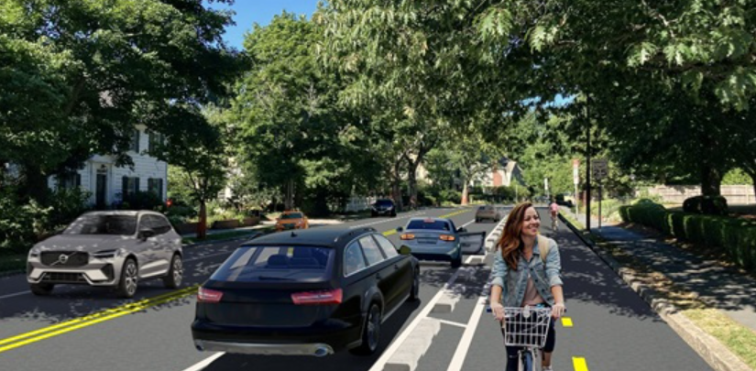
5th Avenue Bike Lane Protection Alternatives

Slide 2
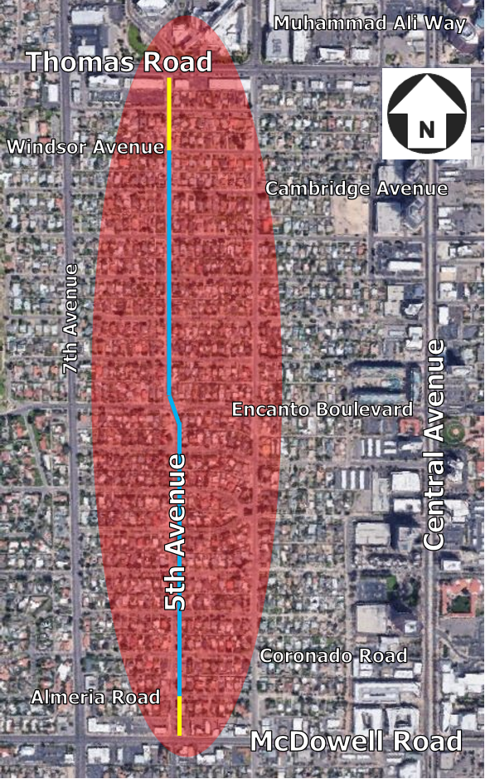
5TH AVE – DESIGN ELEMENTS
Southbound bike lane with side walks south of Encanto Boulevard
ADA Ramps
Southbound bike lane with pedestrian access north of Encanto Boulevard
All-way Stop at Encanto Boulevard
On-street parking
One-way southbound traffic
Notes:
Note that the scope of this project has been outside the resources of the pavement maintenance team, the sidewalk/street modernization program, and local drainage solutions projects.

Slide 3
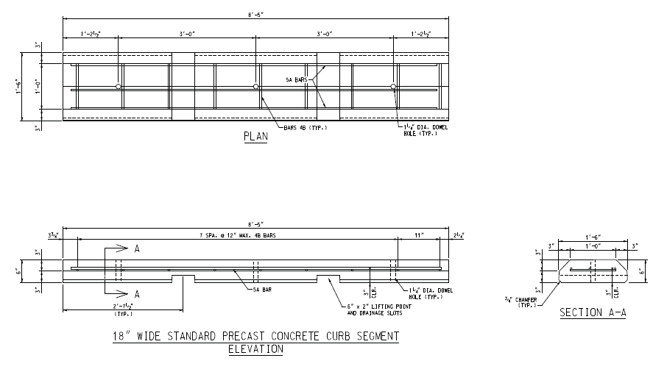
Precast Curb Detail

Slide 4
5th Avenue – South of Encanto Boulevard
Vertical Bike Lane Protection Features
Precast concrete curb segments measure 8 feet 5 inches in length, 1 foot 6 inches in width, and 6 inches in height.
The curb segments are installed at an approximate spacing of 8 to 10 feet apart.
Cast-in-place concrete curbs are used at intersections to narrow entry points, ensuring better control and guidance.
Notes:
Note that the scope of this project has been outside the resources of the pavement maintenance team, the sidewalk/street modernization program, and local drainage solutions projects.

Slide 5
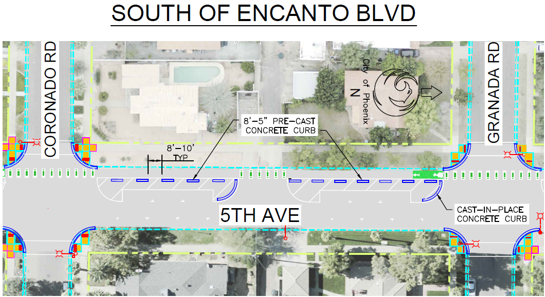
Parking Separated Bike Lanes

Slide 6
Benefits of Parking Separated Bike Lanes
Parked cars in the buffer zones enhance the level of protection for cyclists.
The placement of concrete curbs closer to the bike lanes helps to minimize confusion for motorists, improving access clarity.
There is a potential to reduce vehicle speeds, promoting safer conditions for cyclists.
Notes:
Note that the scope of this project has been outside the resources of the pavement maintenance team, the sidewalk/street modernization program, and local drainage solutions projects.

Slide 7
Separated Pedestrian Access & Bike Lanes
5th Avenue Pedestrian Access (North of Encanto Blvd):
Combined Northbound/Southbound Pedestrian Access
South Bound Bike Lane
PARKING

Slide 8
5th Avenue – North of Encanto Boulevard
Vertical Protection Features
Precast concrete curb segments measure 8 feet 5 inches in length, 1 foot 6 inches in width, and 6 inches in height.
The curb segments are installed at an approximate spacing of 8 to 10 feet apart.
Tuff curb installed at critical intersections and access points improving access clarity.
Notes:
Note that the scope of this project has been outside the resources of the pavement maintenance team, the sidewalk/street modernization program, and local drainage solutions projects.

Slide 9
Separated Pedestrian Access & Bike

Slide 10
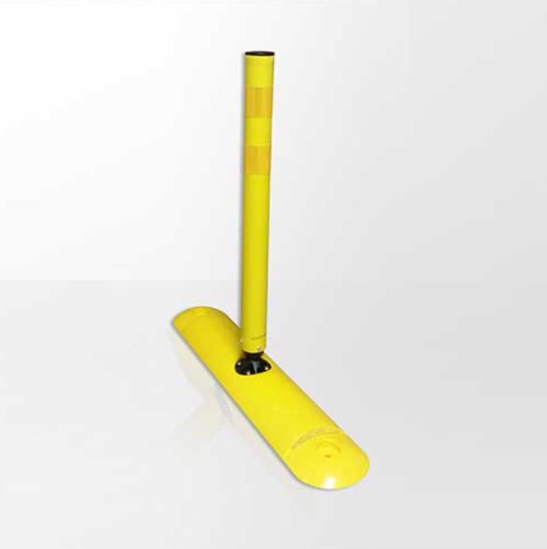
Separated Pedestrian Access & Bike
Tuff Curb Flexible Delineator

Slide 11
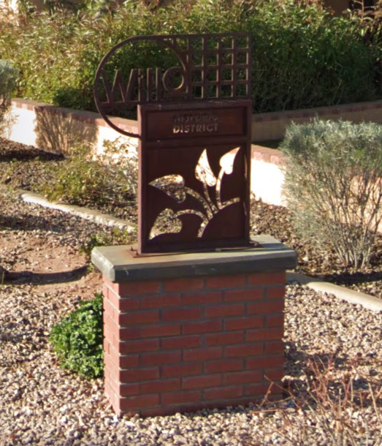
Open Discussion
Thank You!

